Slide 1
AI-DRIVEN WASTE MANAGEMENT
Final Project Presentation
ORGANIC
PLASTIC
PAPER
Team Members:
Jobina | Devi
Anand | Riyo
Nikhil | Vishnu
Devanshkumar | Sruthimol
Jeffin

Slide 2
PROJECT BOARD

Slide 3
Implemented Models
1
EfficientNet B0
2
ResNet50
3
VGG-16

Slide 4
EfficientNet B0

Slide 5
ResNet 50

Slide 6
VGG-16

Slide 7
Tuning the best model

Slide 8
USER INTERFACE

Slide 12
Class Distribution in training Dataset

Slide 13
Class Distribution in training Dataset

Slide 14
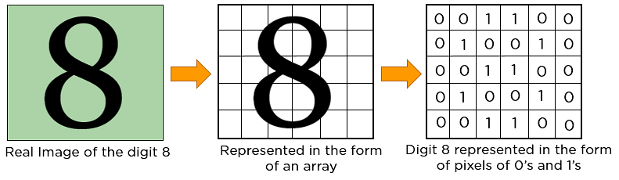
Model Building and evaluation. (CNN)
Uses Conventional Neural network
Feed-forward neural network
Analyze visual images
Grid-like topology
Detect and classify objects in an image
Uses linear algebra, specifically matrix multiplication
Requires graphical processing units (GPUs) to train models

Slide 15
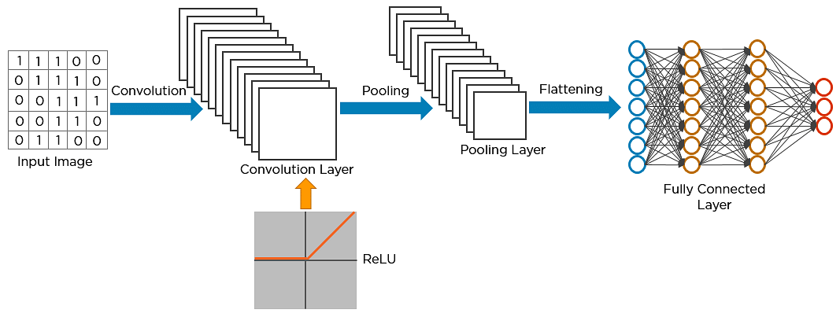
Layers of CNN
Convolution layer
ReLU layer
Pooling layer
Fully connected layer

Slide 16
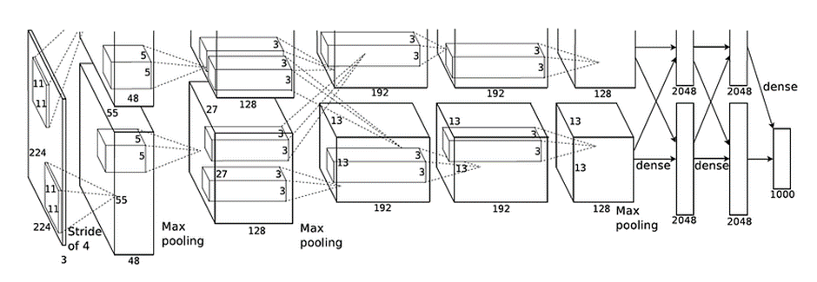
1. AlexNet
The network's architecture, consisting of five convolutional layers followed by three fully connected layers, allowed it to learn hierarchical representations of images, capturing low-level to high-level features effectively.
Advantages
Revolutionized Image Classification
Deep Architecture -- enables the model to learn complex features
ReLU (Rectified Linear Unit) activation function helps to address the vanishing gradient problem
GPU Acceleration -- Significantly reduced training time
Validation Matrix
Confusion Matrix
Precision, Recall, and F1 Score
ROC-AUC Curve

Slide 17
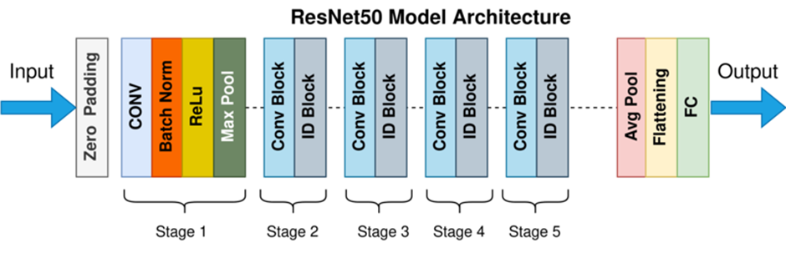
2. ResNet50
It is a groundbreaking deep learning architecture with 50 layers that addresses the degradation problem in deep networks through residual learning. By using residual blocks, it enables very deep networks to be trained effectively, overcoming issues like vanishing and exploding gradients.
Advantages
Robustness
Modularity and Flexibility
Prevents Degradation Problem –ResNet ensures that additional layers do not worsen performance.
Validation Metrics
Confusion Matrix
Precision, Recall, F1 Score
ROC-AUC Curve

Slide 18
3.EfficientNet B0
EfficientNet is a family of convolutional neural networks (CNNs) developed by Google AI that provides a highly efficient model architecture for image classification and other computer vision tasks.
Advantages of EfficientNet-B0 Over Other Models
Better Performance with Fewer Parameters:
Achieves high accuracy with significantly fewer parameters.
Example: 5.3 million parameters with comparable performance to larger models.
Scalability:
Compound scaling uniformly scales network width, depth, and resolution.
Range of models (EfficientNet-B0 to B7) for different resource and performance needs.
Computational Efficiency:
Suitable for resource-constrained environments like mobile devices.
Lower energy consumption due to reduced computational load.
4. Advanced Building Blocks:
Depthwise separable convolutions reduce computational complexity.
SE layers enhance feature representation.
MBConv blocks improve training efficiency and performance.

Slide 19
5. Flexibility and Adaptability:​
Versatile for various tasks beyond image classification.​
Effective for transfer learning.​
6 Ease of Use:​
Pre-trained models available on popular frameworks.​
Extensive community support.​
Why Choose EfficientNet-B0 Over Other Models?
Optimal Trade-off: Balances model size, computational efficiency, and accuracy.
Scalability Options: Choose models based on resource constraints and performance needs.
Deployment Flexibility: Ideal for limited-resource environments like mobile and edge devices.
Cutting-Edge Performance: State-of-the-art architecture with high performance and fewer parameters.

Slide 20

Thanks!
Do you have any questions?
PAPER

